Slide 1
Hurtownie Danych
SSIS Podstawy cz.1

Slide 2
Connection Managers

Slide 3
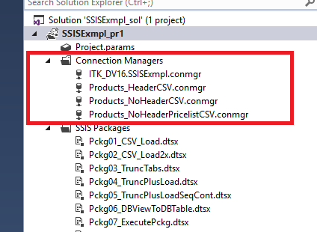
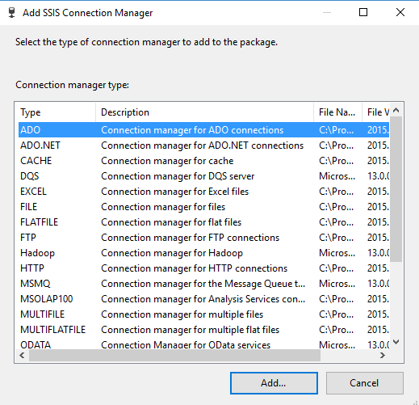
Connection Manager
Integration Services uses the connection manager as a logical representation of a connection. At design time, you set the properties of a connection manager to describe the physical connection that Integration Services creates when the package runs.
A connection manager can be created at the package level or at the project level. The connection manager created at the project level is available all the packages in the project. Whereas, connection manager created at the package level is available to that specific package.
https://docs.microsoft.com/en-us/sql/integration-services/connection-manager/integration-services-ssis-connections

Slide 4
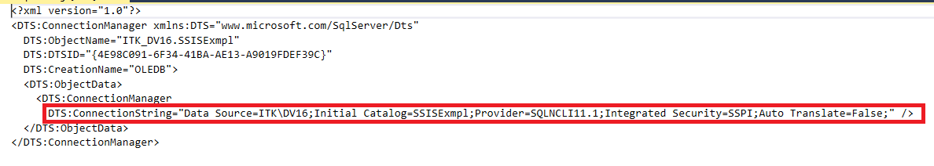
Connection String
In computing, a connection string is a string that specifies information about a data source and the means of connecting to it. It is passed in code to an underlying driver or provider in order to initiate the connection. Whilst commonly used for a database connection, the data source could also be a spreadsheet or text file.
The connection string may include attributes such as the name of the driver, server and database, as well as security information such as user name and password.
https://en.wikipedia.org/wiki/Connection_string

Slide 5
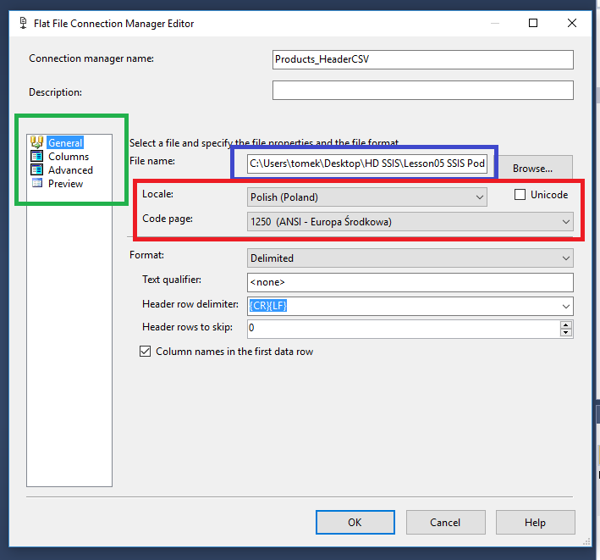
Flat File Connection Manager
A Flat File connection manager enables a package to access data in a flat file. The Flat File connection manager can access only one file.
https://docs.microsoft.com/en-us/sql/integration-services/connection-manager/flat-file-connection-manager

Slide 6
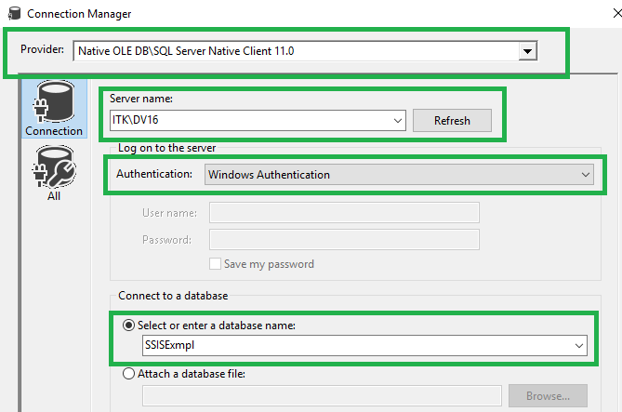
OLE DB Connection Manager
An OLE DB connection manager enables a package to connect to a data source by using an OLE DB provider. For example, an OLE DB connection manager that connects to SQL Server can use the Microsoft OLE DB Provider for SQL Server.
Several SQL Server Integration Services tasks and data flow components use an OLE DB connection manager. For example, the OLE DB source and OLE DB destination use this connection manager to extract and load data, and the Execute SQL task can use this connection manager to connect to a SQL Server database to run queries.
https://docs.microsoft.com/en-us/sql/integration-services/connection-manager/ole-db-connection-manager

Slide 7
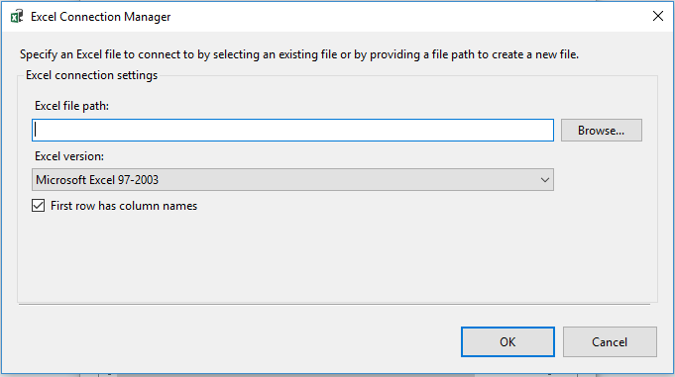
Excel Connection Manager
An Excel connection manager enables a package to connect to an existing Microsoft Excel workbook file. The Excel source and the Excel destination that Microsoft SQL Server Integration Services includes use the Excel connection manager.
https://docs.microsoft.com/en-us/sql/integration-services/connection-manager/excel-connection-manager

Slide 8
Control Flow

Slide 9
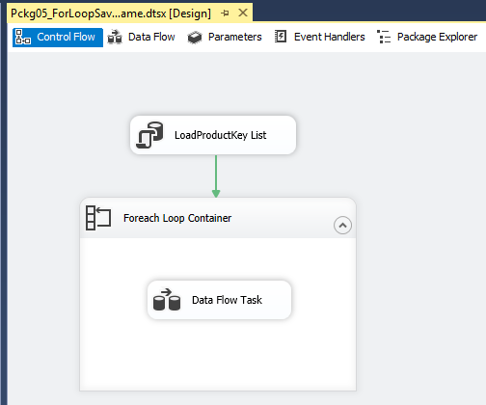
Control Flow
A package consists of a control flow and, optionally, one or more data flows. SQL Server Integration Services provides three different types of control flow elements:
containers that provide structures in packages,
tasks that provide functionality
precedence constraints that connect the executables, containers, and tasks into an ordered control flow.

Slide 10
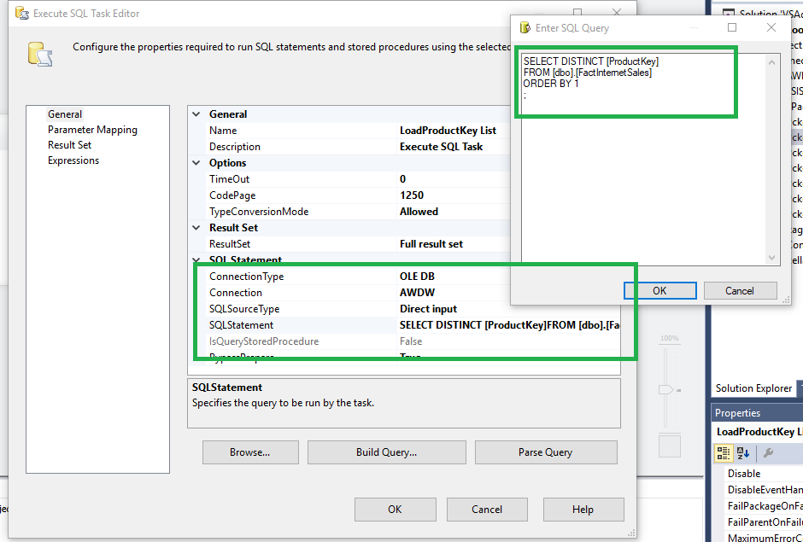
Execute SQL Task
The Execute SQL task runs SQL statements or stored procedures from a package. The task can contain either a single SQL statement or multiple SQL statements that run sequentially. You can use the Execute SQL task for the following purposes:
Truncate a table or view in preparation for inserting data.
Create, alter, and drop database objects such as tables and views.
Re-create fact and dimension tables before loading data into them.
…
https://docs.microsoft.com/en-us/sql/integration-services/control-flow/execute-sql-task

Slide 11
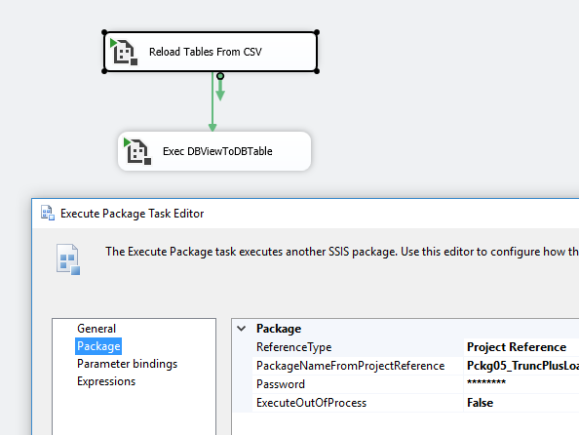
Execute Package Task
The Execute Package task extends the enterprise capabilities of Integration Services by letting packages run other packages as part of a workflow.
You can use the Execute Package task for the following purposes:
Breaking down complex package workflow.
Reusing parts of packages.
Grouping work units.
https://docs.microsoft.com/en-us/sql/integration-services/control-flow/execute-package-task

Slide 12
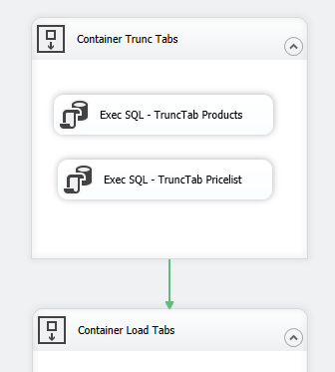
Sequence Container
Precedence constraints link executables, containers, and tasks in packages in a control flow, and specify conditions that determine whether executables run.
A precedence constraint links two executables: the precedence executable and the constrained executable. The precedence executable runs before the constrained executable, and the execution result of the precedence executable may determine whether the constrained executable runs.
https://docs.microsoft.com/en-us/sql/integration-services/control-flow/precedence-constraints

Slide 13
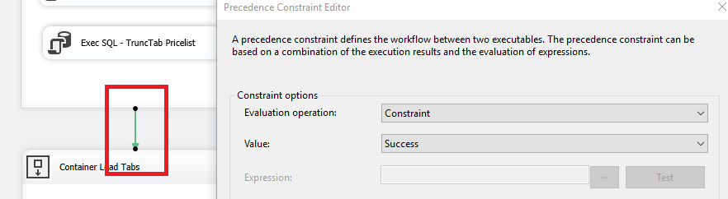
Precedence Constraints
The Sequence container defines a control flow that is a subset of the package control flow. Sequence containers group the package into multiple separate control flows, each containing one or more tasks and containers that run within the overall package control flow.
The Sequence container can include multiple tasks in addition to other containers. Adding tasks and containers to a Sequence container is similar to adding them to a package, except you drag the tasks and containers to the Sequence container instead of to the package container.
https://docs.microsoft.com/en-us/sql/integration-services/control-flow/sequence-container

Slide 14
Data Flow Task
The Data Flow task encapsulates the data flow engine that moves data between sources and destinations, and lets the user transform, clean, and modify data as it is moved. Addition of a Data Flow task to a package control flow makes it possible for the package to extract, transform, and load data.
A data flow consists of at least one data flow component, but it is typically a set of connected data flow components:
sources that extract data;
transformations that modify, route, or summarize data;
destinations that load data.
At run time, the Data Flow task builds an execution plan from the data flow, and the data flow engine executes the plan. You can create a Data Flow task that has no data flow, but the task executes only if it includes at least one data flow.
https://docs.microsoft.com/en-us/sql/integration-services/control-flow/data-flow-task

Slide 15
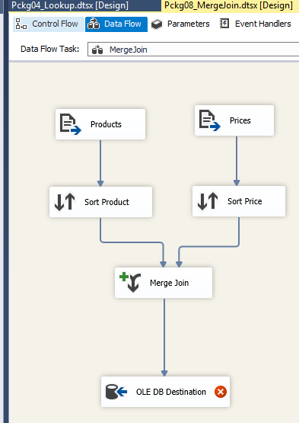
Data Flow Task

Slide 16
Source & Destination

Slide 17
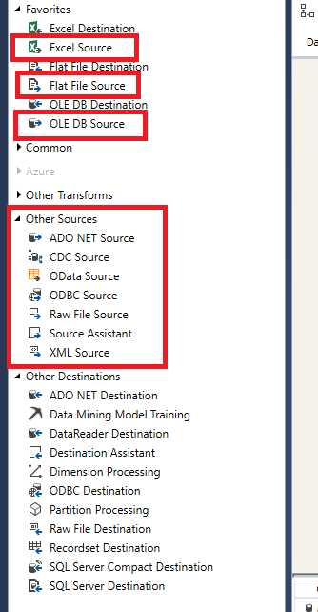
Source
Sources are the data flow components that make data from different types of data sources available to a data flow. Sources have one regular output, and many sources also have one error output.
There are three types of sources:
Sources that Setup installs when you install Integration Services.
Sources that are available to download from the Microsoft Web site.
Custom sources that you create if the existing sources do not meet your needs.
https://technet.microsoft.com/en-us/library/ms141093(v=sql.105).aspx

Slide 18
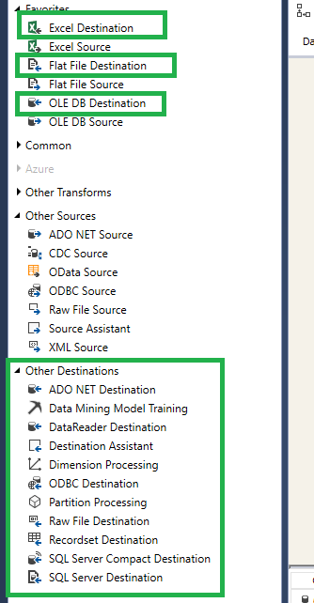
Destination
Destinations are the data flow components that load the data in a data flow into different types of data sources or create an in-memory dataset. Destinations have one input and one error output.
There are three types of destinations:
Destinations that Setup installs when you install Integration Services.
Destinations that are available to download from the Microsoft Web site.
Custom destinations that you create if the existing destinations do not meet your needs.
https://technet.microsoft.com/en-us/library/ms141089(v=sql.105).aspx

